Slide 1
Introduction to Machine Learning
Amal Joseph
Machine Learning Engineer @ Arcesium
“Let us see what is out there..”

Slide 2
Overview
What’s Machine Learning?
Programming vs Machine Learning?
Machine Learning Pipeline
When to use ML?
Applications of ML
Types of Learning
Familiarize, don’t Memorize

Slide 3
What is Machine Learning?
“Machine learning enables a machine to automatically learn from data, improve performance from experiences, and predict things without being explicitly programmed.”
Arthur Samuel, 1959
A computer program is said to learn from experience E with respect to some class of tasks T and performance measure P, if its performance at tasks in T, as measured by P, improves with experience E.
Tom Mitchell

Slide 4
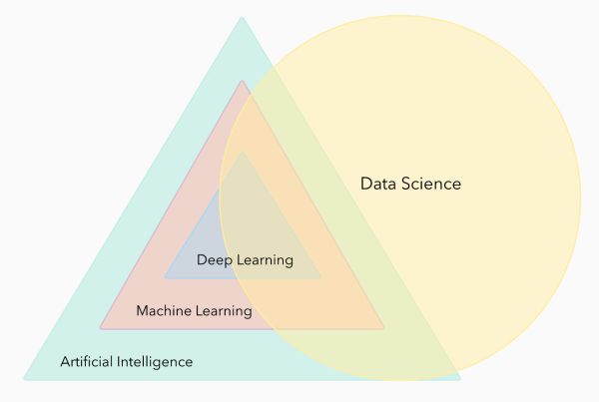
What is what?

Slide 5
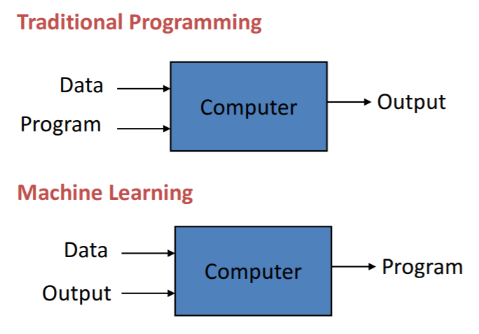
Programming vs Machine Learning

Slide 6
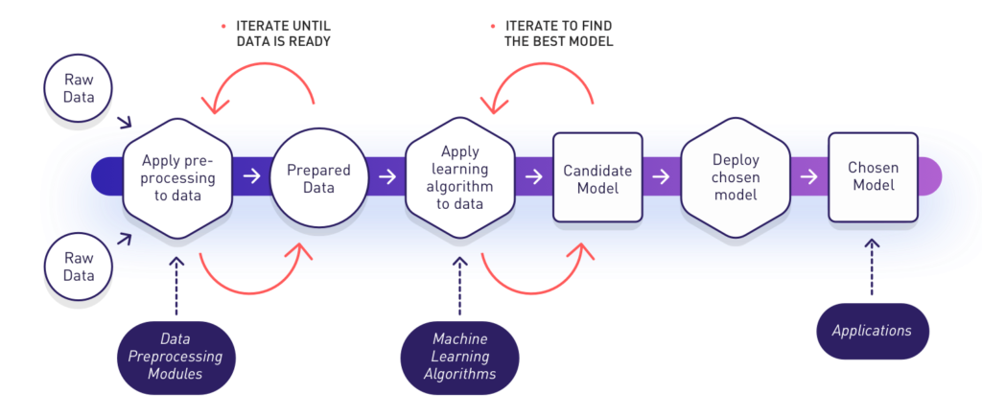
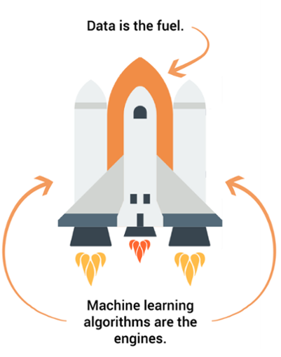
Machine Learning Pipeline

Slide 7
When should we make the Machine Learn?
ML is used when:
Human expertise does not exist (navigating on Mars)
Humans can’t explain their expertise (speech recognition)
Models must be customized (personalized medicine)
Models are based on huge amounts of data (genomics)
Learning isn’t always useful - There is no need to “learn” to calculate payroll

Slide 8
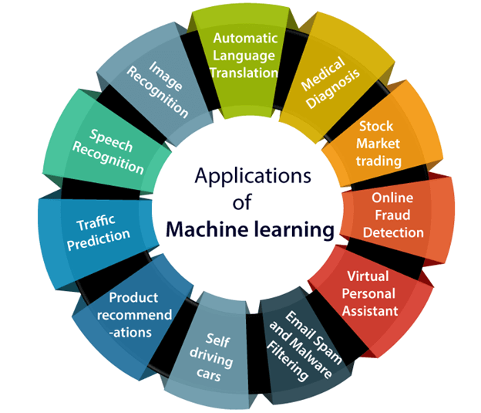
Applications of Machine Learning

Slide 9
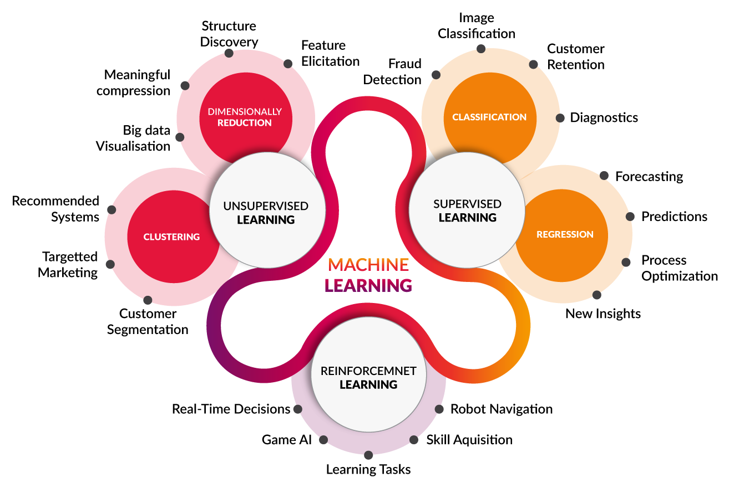
Types of Learning

Slide 10
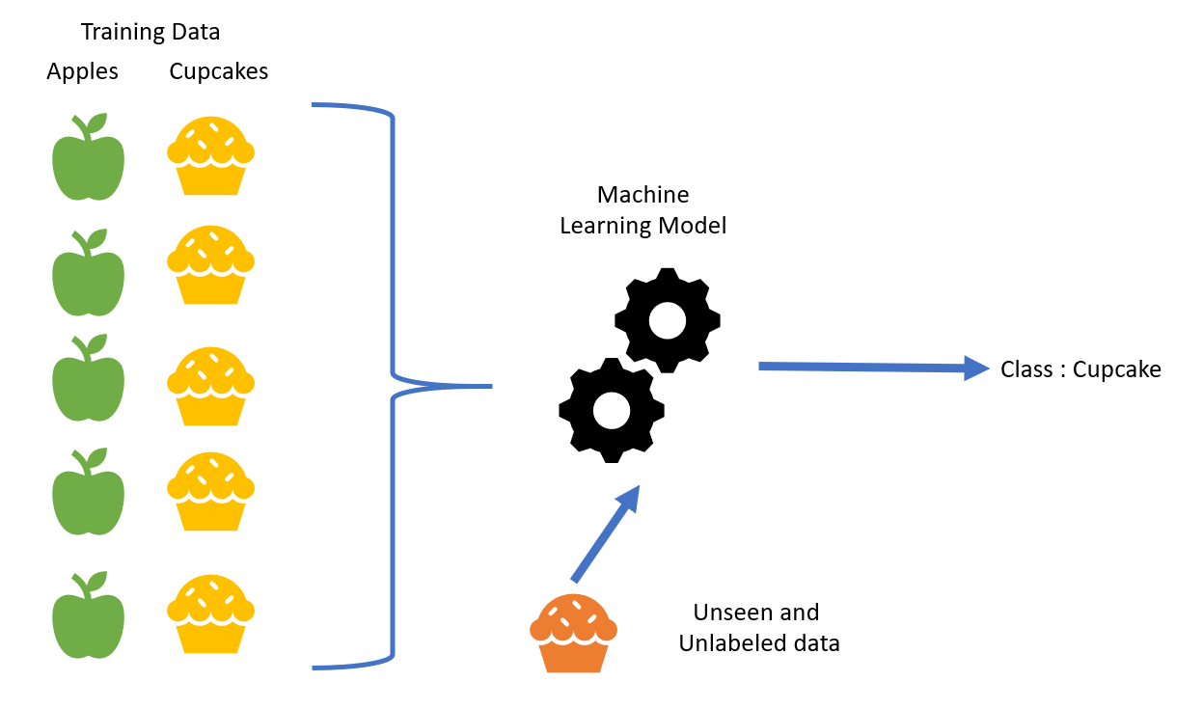





SUPERVISED LEARNING
Input : Labeled Data
Goal : Construct a predictor
to minimize the error between
where,
Use : using predictor to predict
For the unknown input

Slide 11
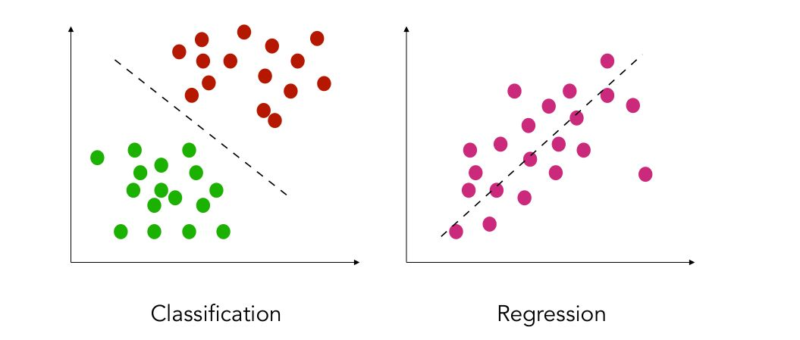
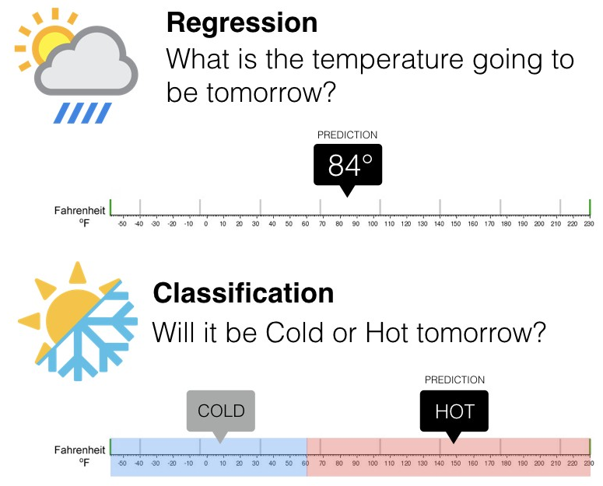
SUPERVISED LEARNING
Classification
features and discrete labels
maps an input to discrete label(class)
Eg: spam or not, type of cancer
Regression
features and continues real values
Predict a real value for an input
Eg: gold price, temperature

Slide 12
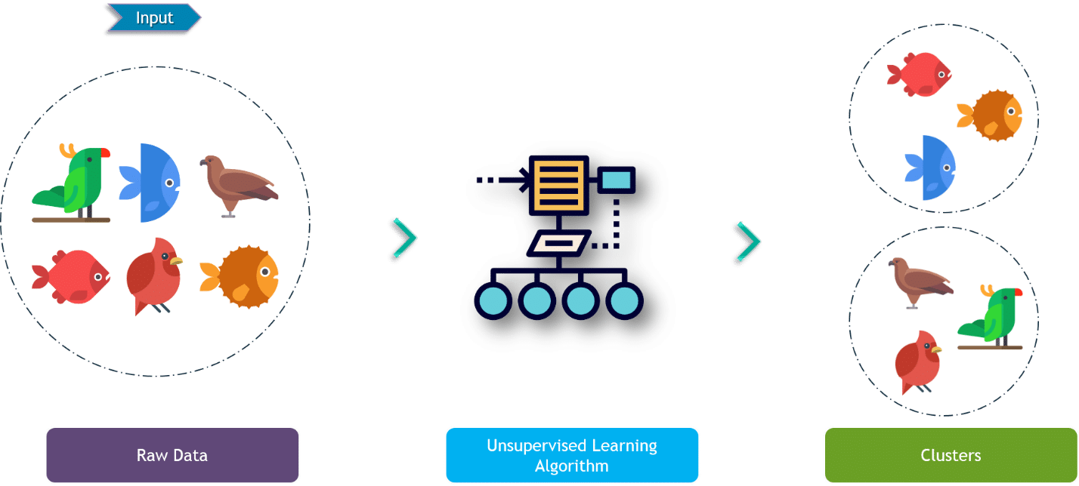
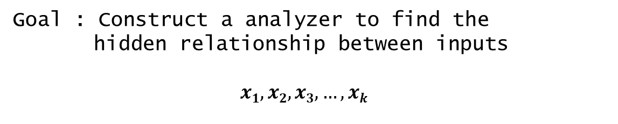
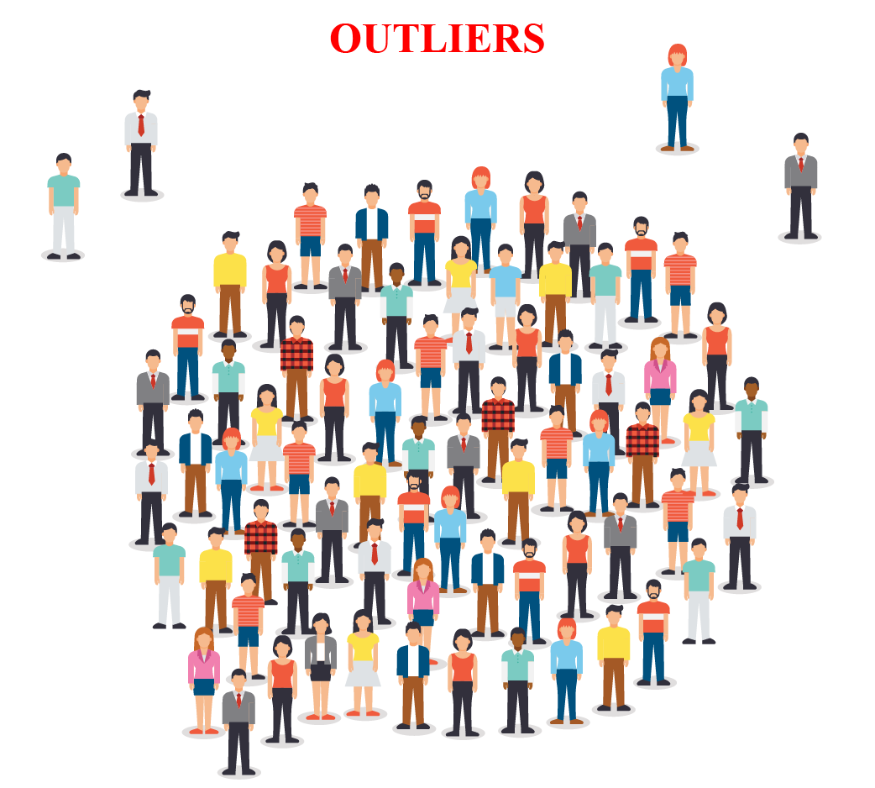
UNSUPERVISED LEARNING
. . .
Input : Unlabeled Data
Use : Group or associate inputs according to their similarity

Slide 13
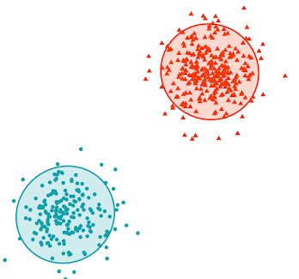
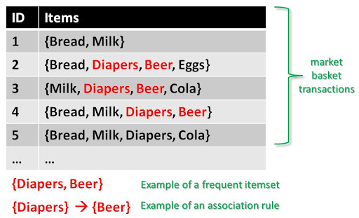
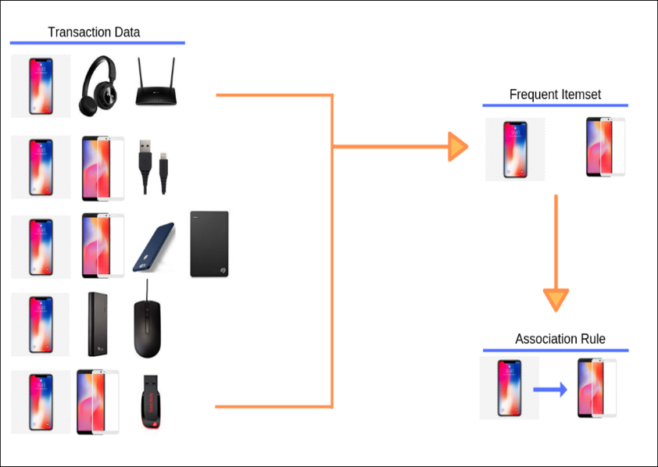
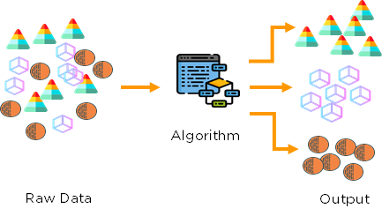
UNSUPERVISED LEARNING
Clustering
Itemset and Rule mining

Slide 14
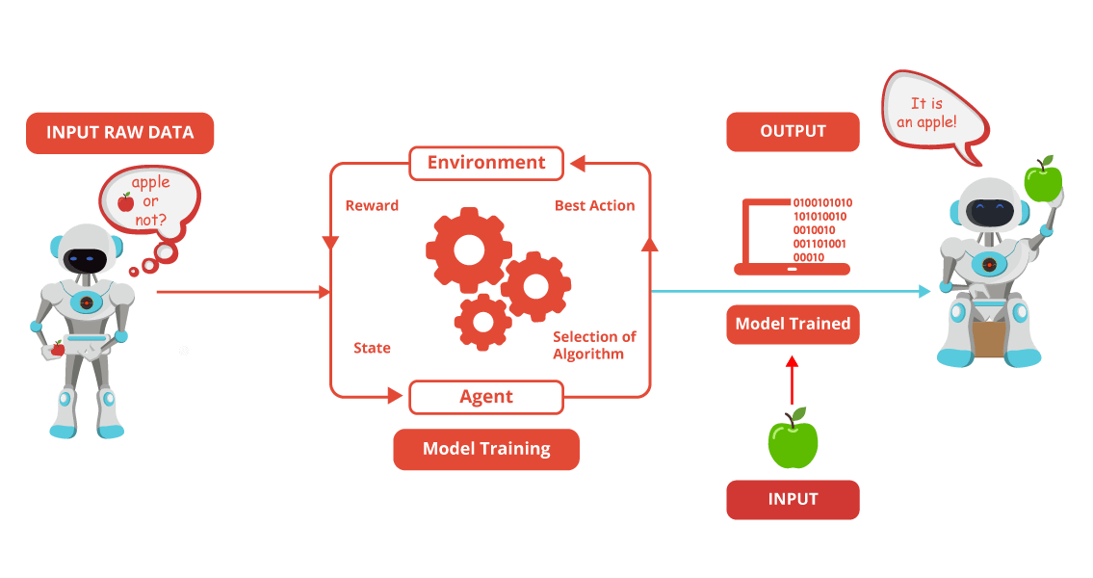
REINFORCEMENT LEARNING
Use software agents
Based on rewards
Objective is to maximize rewards for better learning

Slide 15
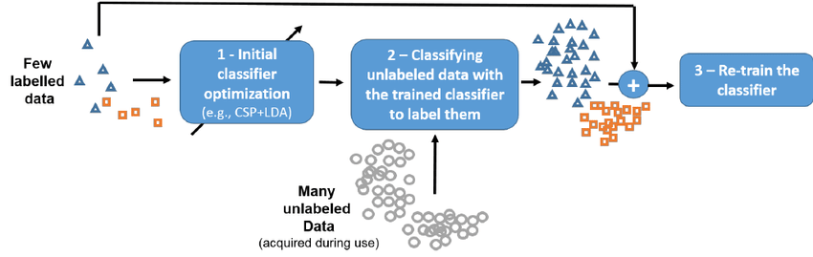
SEMI SUPERVISED LEARNING

Slide 16




Familiarize, don’t Memorize
And Familiarity comes with practice..

